Slide 1

Formatage du code source
025947 - Documentation logicielle, bonnes pratiques en programmation
Steve Fotso
025914 - Assurance de qualité logicielle

Slide 2
Le but du formatage
Faire fonctionner le code n’est pas suffisant
Il est important que le code soit lisible
Le formatage est un outil de communication pour les programmeurs professionnels
Le formatage du code a un effet sur toutes les modifications qui seront apportées au code (maintance et extension du code)
Notes:
The consequences of these can prove to be extremely frustrating and expensive:
The general perception of the quality of the output begins to deteriorate as the team spends more and more time in fixing bugs than in actually creating new features
In extreme cases, adding features becomes virtually impossible with seemingly unrelated parts of the system failing due to the addition of a feature or, worse – fixing an earlier bug
Costs of adding features increases at an alarming rate with each delivery cycle
Adding more people becomes difficult, as they take a long time to come up to speed; sometimes, new team members are blatantly scared to touch large parts of the code, due to the fear of failure
Customer complaints increase, putting intense pressure to write an even worse code – to keep fixing the issues quickly

Slide 3
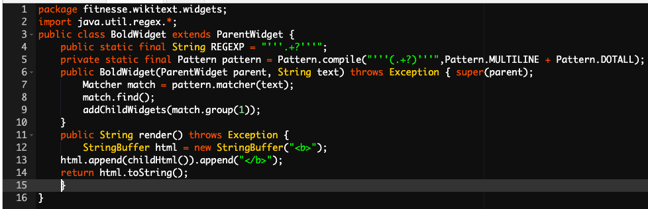
Formatage vertical
Le code source devrait être similaire à un journal quotidien
Les blocs de code avec des idées différentes doivent être séparés
Notes:
The consequences of these can prove to be extremely frustrating and expensive:
The general perception of the quality of the output begins to deteriorate as the team spends more and more time in fixing bugs than in actually creating new features
In extreme cases, adding features becomes virtually impossible with seemingly unrelated parts of the system failing due to the addition of a feature or, worse – fixing an earlier bug
Costs of adding features increases at an alarming rate with each delivery cycle
Adding more people becomes difficult, as they take a long time to come up to speed; sometimes, new team members are blatantly scared to touch large parts of the code, due to the fear of failure
Customer complaints increase, putting intense pressure to write an even worse code – to keep fixing the issues quickly

Slide 4
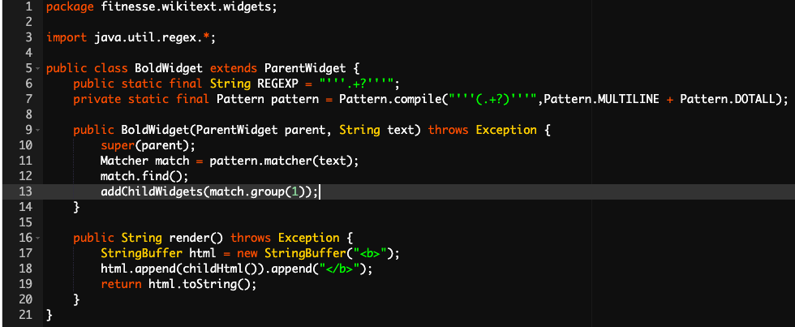
Formatage vertical (suite)
Notes:
The consequences of these can prove to be extremely frustrating and expensive:
The general perception of the quality of the output begins to deteriorate as the team spends more and more time in fixing bugs than in actually creating new features
In extreme cases, adding features becomes virtually impossible with seemingly unrelated parts of the system failing due to the addition of a feature or, worse – fixing an earlier bug
Costs of adding features increases at an alarming rate with each delivery cycle
Adding more people becomes difficult, as they take a long time to come up to speed; sometimes, new team members are blatantly scared to touch large parts of the code, due to the fear of failure
Customer complaints increase, putting intense pressure to write an even worse code – to keep fixing the issues quickly

Slide 5
Formatage vertical (suite)
Les variables doivent être définies proches de leur usage
Les variables d’instances doivent être déclarées au début de la classe
Les fonctions dépendantes doivent être proches
Exemple: https://onlinegdb.com/r1rUwcqAD
Notes:
The consequences of these can prove to be extremely frustrating and expensive:
The general perception of the quality of the output begins to deteriorate as the team spends more and more time in fixing bugs than in actually creating new features
In extreme cases, adding features becomes virtually impossible with seemingly unrelated parts of the system failing due to the addition of a feature or, worse – fixing an earlier bug
Costs of adding features increases at an alarming rate with each delivery cycle
Adding more people becomes difficult, as they take a long time to come up to speed; sometimes, new team members are blatantly scared to touch large parts of the code, due to the fear of failure
Customer complaints increase, putting intense pressure to write an even worse code – to keep fixing the issues quickly

Slide 6
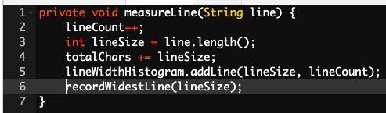
Formatage horizontal
Le formatage horizontal associe les éléments fortement reliés et dissocie les éléments faible reliés
Notes:
The consequences of these can prove to be extremely frustrating and expensive:
The general perception of the quality of the output begins to deteriorate as the team spends more and more time in fixing bugs than in actually creating new features
In extreme cases, adding features becomes virtually impossible with seemingly unrelated parts of the system failing due to the addition of a feature or, worse – fixing an earlier bug
Costs of adding features increases at an alarming rate with each delivery cycle
Adding more people becomes difficult, as they take a long time to come up to speed; sometimes, new team members are blatantly scared to touch large parts of the code, due to the fear of failure
Customer complaints increase, putting intense pressure to write an even worse code – to keep fixing the issues quickly

Slide 7
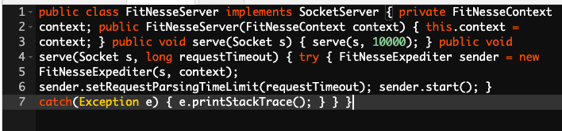
Formatage horizontal(suite)
Considérons le code ci-dessous:
Notes:
The consequences of these can prove to be extremely frustrating and expensive:
The general perception of the quality of the output begins to deteriorate as the team spends more and more time in fixing bugs than in actually creating new features
In extreme cases, adding features becomes virtually impossible with seemingly unrelated parts of the system failing due to the addition of a feature or, worse – fixing an earlier bug
Costs of adding features increases at an alarming rate with each delivery cycle
Adding more people becomes difficult, as they take a long time to come up to speed; sometimes, new team members are blatantly scared to touch large parts of the code, due to the fear of failure
Customer complaints increase, putting intense pressure to write an even worse code – to keep fixing the issues quickly

Slide 8
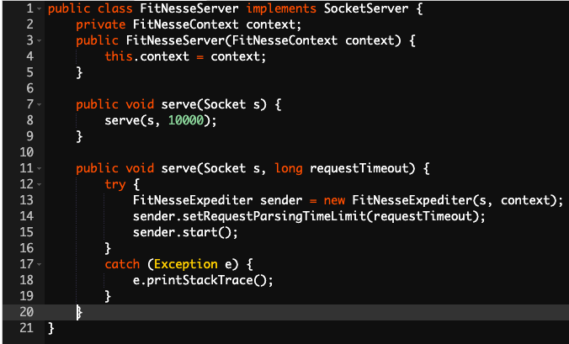
Formatage horizontal(suite)
Notes:
The consequences of these can prove to be extremely frustrating and expensive:
The general perception of the quality of the output begins to deteriorate as the team spends more and more time in fixing bugs than in actually creating new features
In extreme cases, adding features becomes virtually impossible with seemingly unrelated parts of the system failing due to the addition of a feature or, worse – fixing an earlier bug
Costs of adding features increases at an alarming rate with each delivery cycle
Adding more people becomes difficult, as they take a long time to come up to speed; sometimes, new team members are blatantly scared to touch large parts of the code, due to the fear of failure
Customer complaints increase, putting intense pressure to write an even worse code – to keep fixing the issues quickly

Slide 9
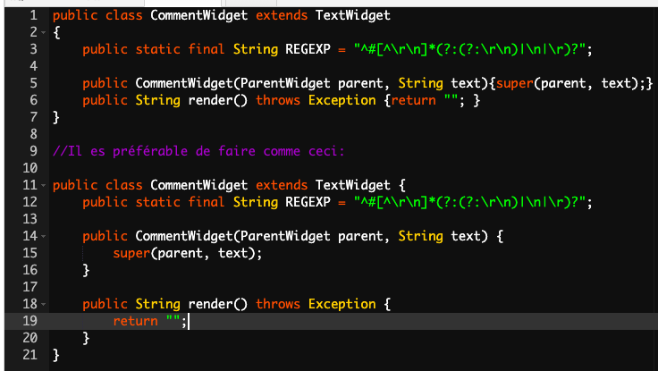
Formatage horizontal(suite)
Inviter de briser les règles d’indentation
Notes:
The consequences of these can prove to be extremely frustrating and expensive:
The general perception of the quality of the output begins to deteriorate as the team spends more and more time in fixing bugs than in actually creating new features
In extreme cases, adding features becomes virtually impossible with seemingly unrelated parts of the system failing due to the addition of a feature or, worse – fixing an earlier bug
Costs of adding features increases at an alarming rate with each delivery cycle
Adding more people becomes difficult, as they take a long time to come up to speed; sometimes, new team members are blatantly scared to touch large parts of the code, due to the fear of failure
Customer complaints increase, putting intense pressure to write an even worse code – to keep fixing the issues quickly

Slide 10
Les règles d’équipe
Les règles d’équipe prennent la précédence
L’essentiel c’est d’avoir des règles de formattage pour le projet et de les appliquer de manière consistente.
Notes:
The consequences of these can prove to be extremely frustrating and expensive:
The general perception of the quality of the output begins to deteriorate as the team spends more and more time in fixing bugs than in actually creating new features
In extreme cases, adding features becomes virtually impossible with seemingly unrelated parts of the system failing due to the addition of a feature or, worse – fixing an earlier bug
Costs of adding features increases at an alarming rate with each delivery cycle
Adding more people becomes difficult, as they take a long time to come up to speed; sometimes, new team members are blatantly scared to touch large parts of the code, due to the fear of failure
Customer complaints increase, putting intense pressure to write an even worse code – to keep fixing the issues quickly

